Slide 1
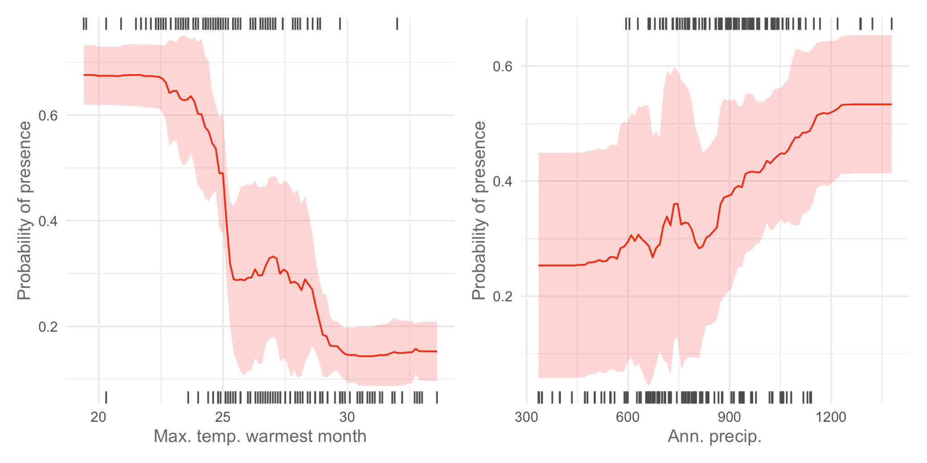
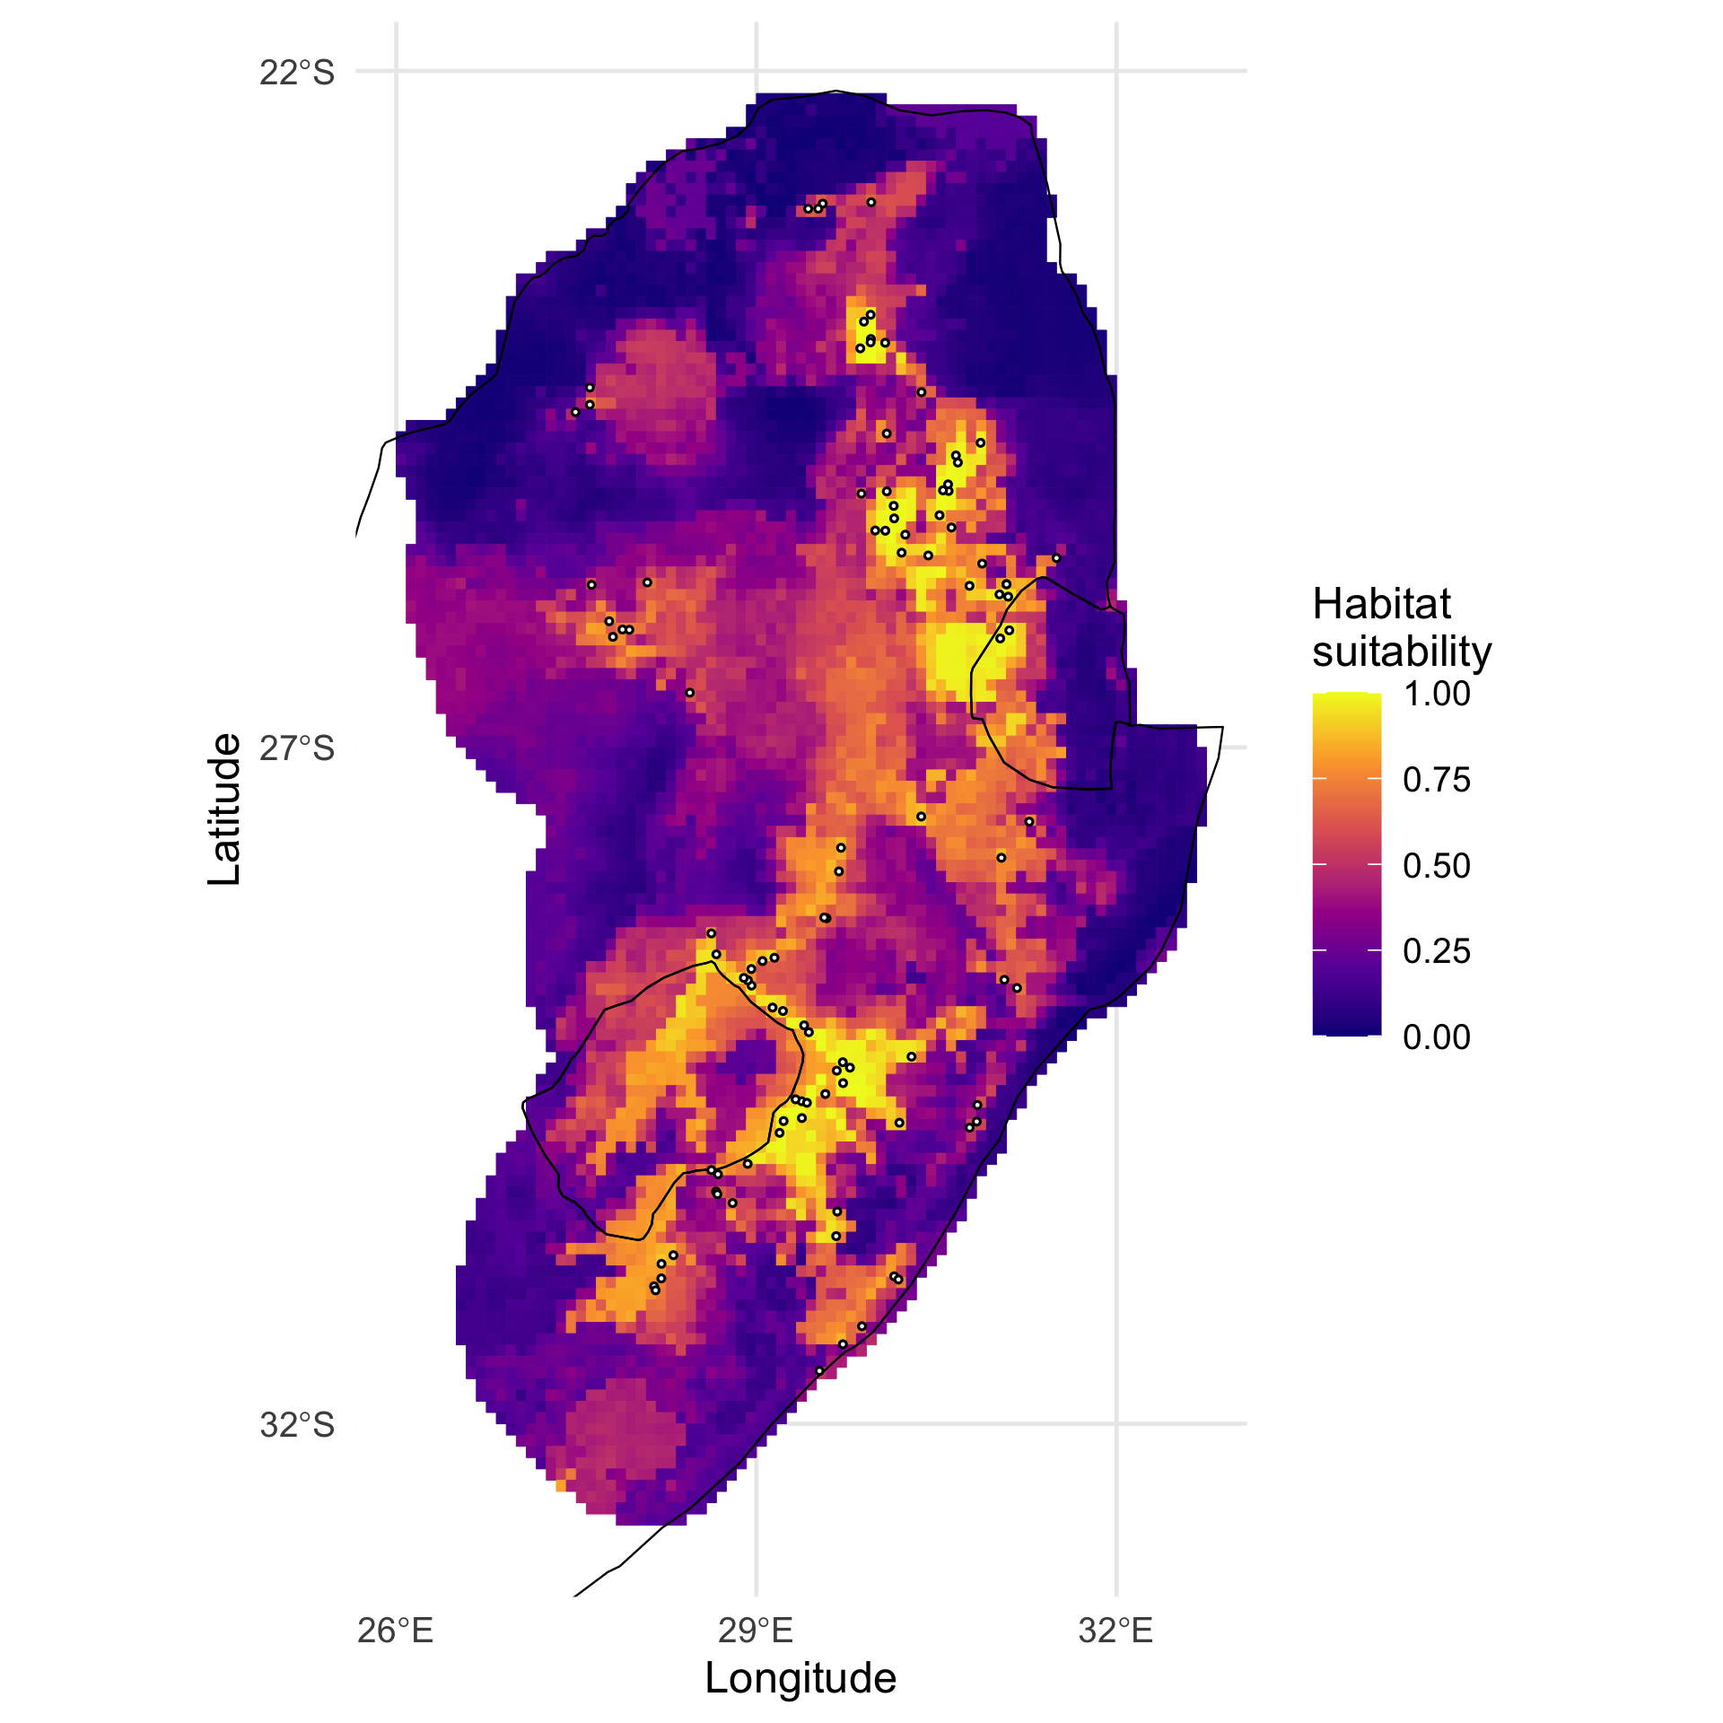
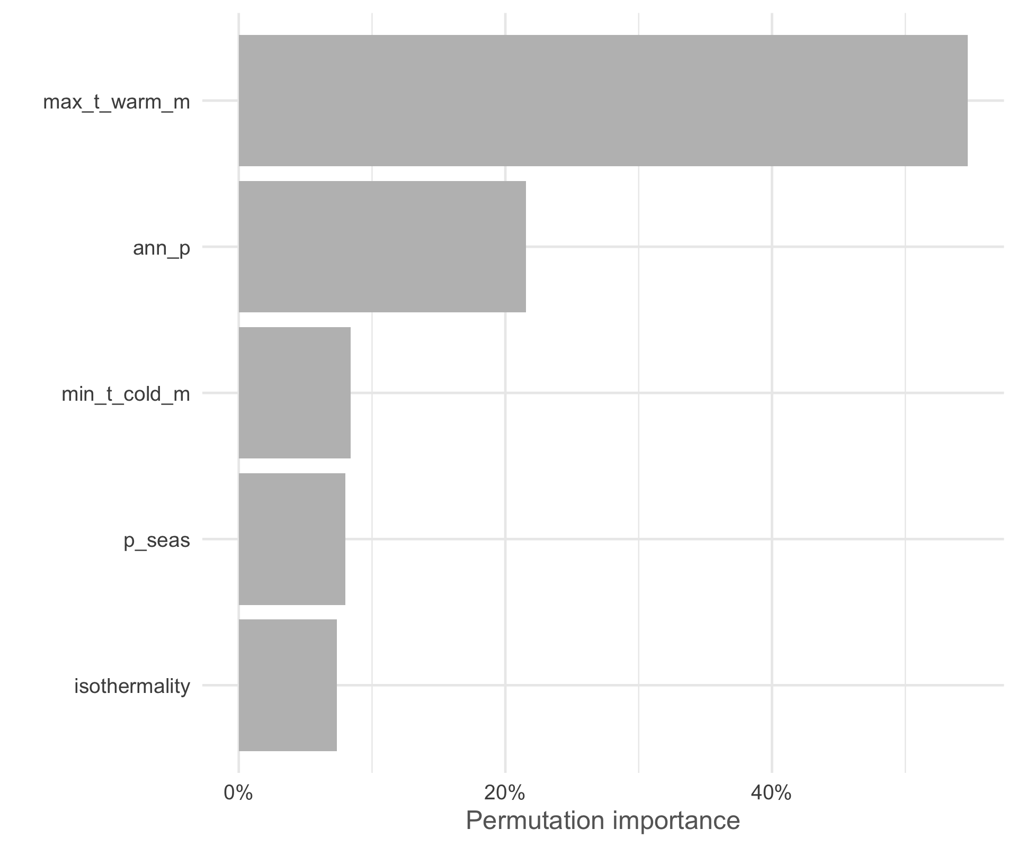
MSc Spatial Analysis Course Day 1
Joseph White, Nicola Kuhn, Carolina Tovar
November 2022

Slide 2
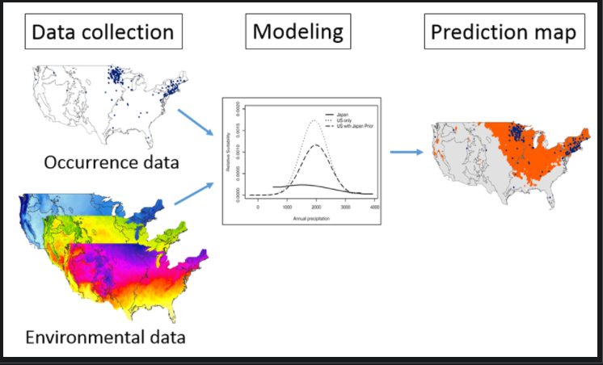
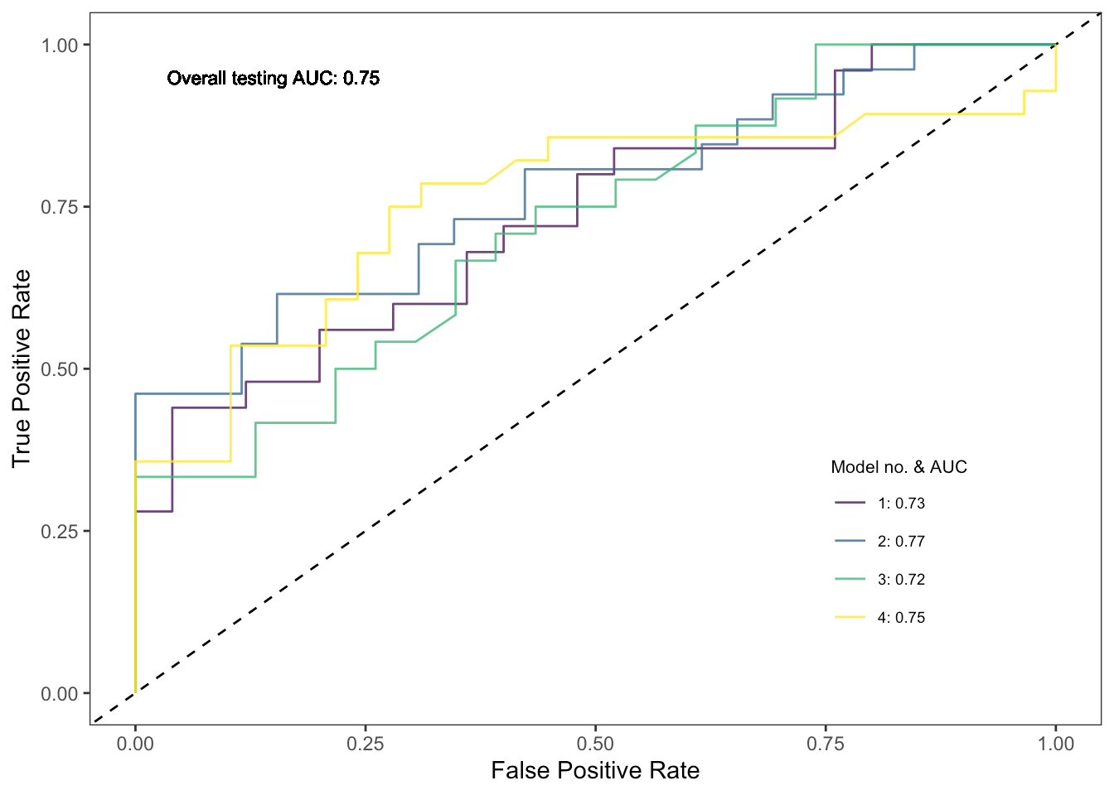
Species Distribution Models
SPATIAL ANALYSIS
Model evaluation

Slide 3
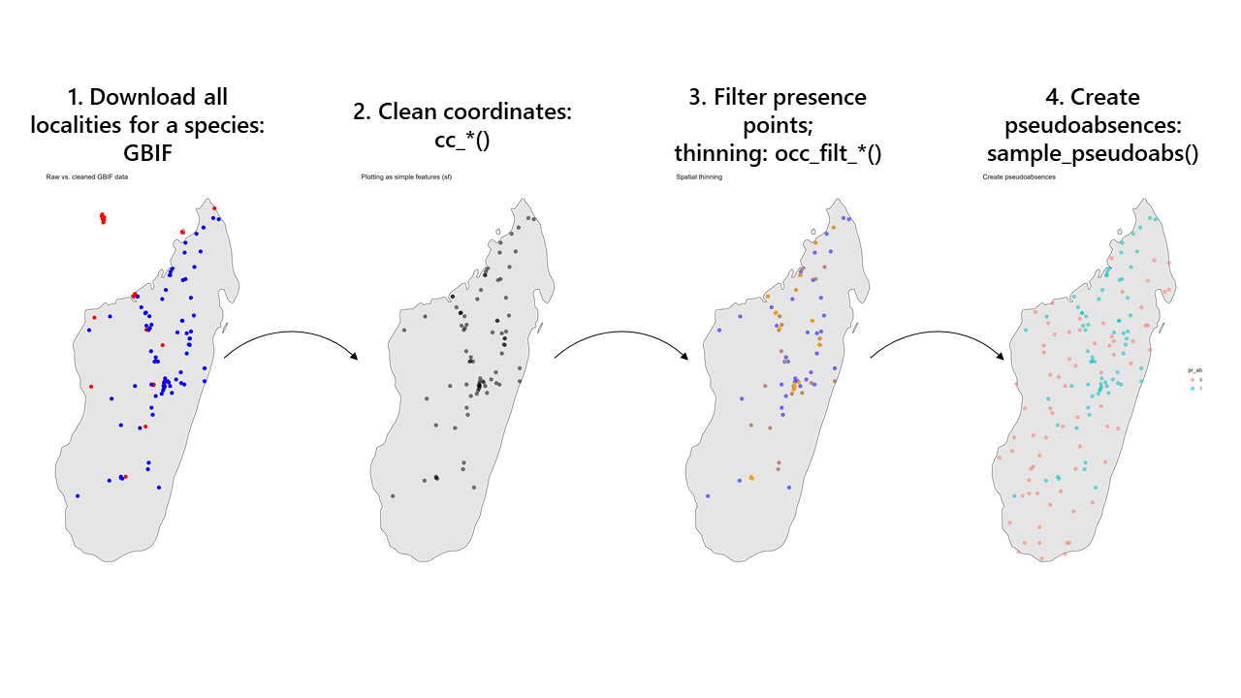
SPATIAL ANALYSIS
Day 1: Locality Data

Slide 4
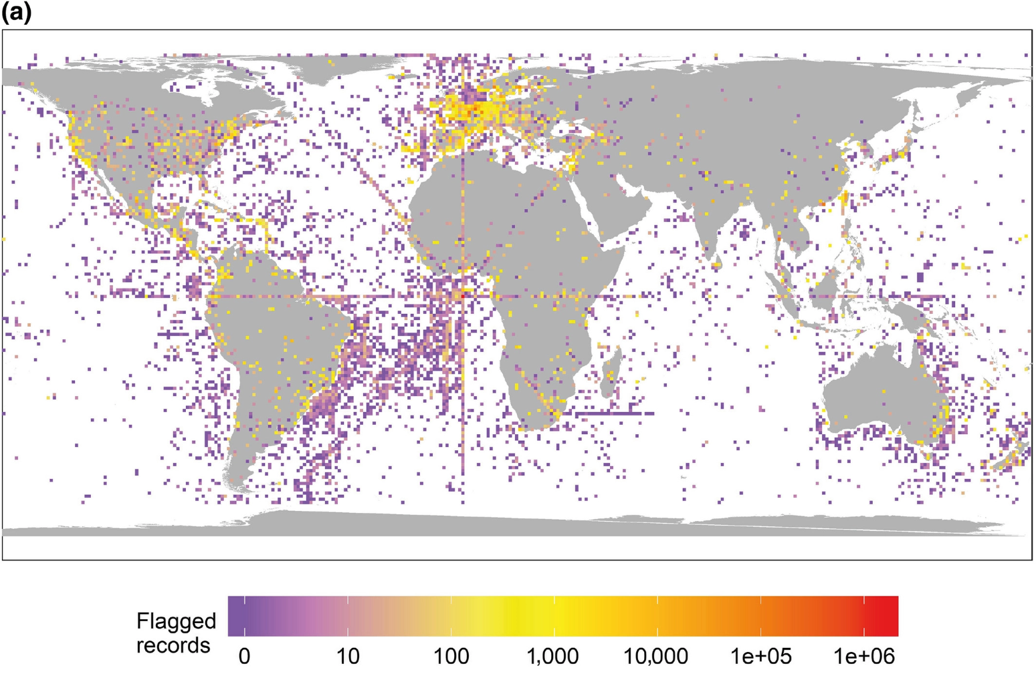
SPATIAL ANALYSIS
Locality Data
c91m; Zizka et al. 2019. CoordinateCleaner

Slide 5
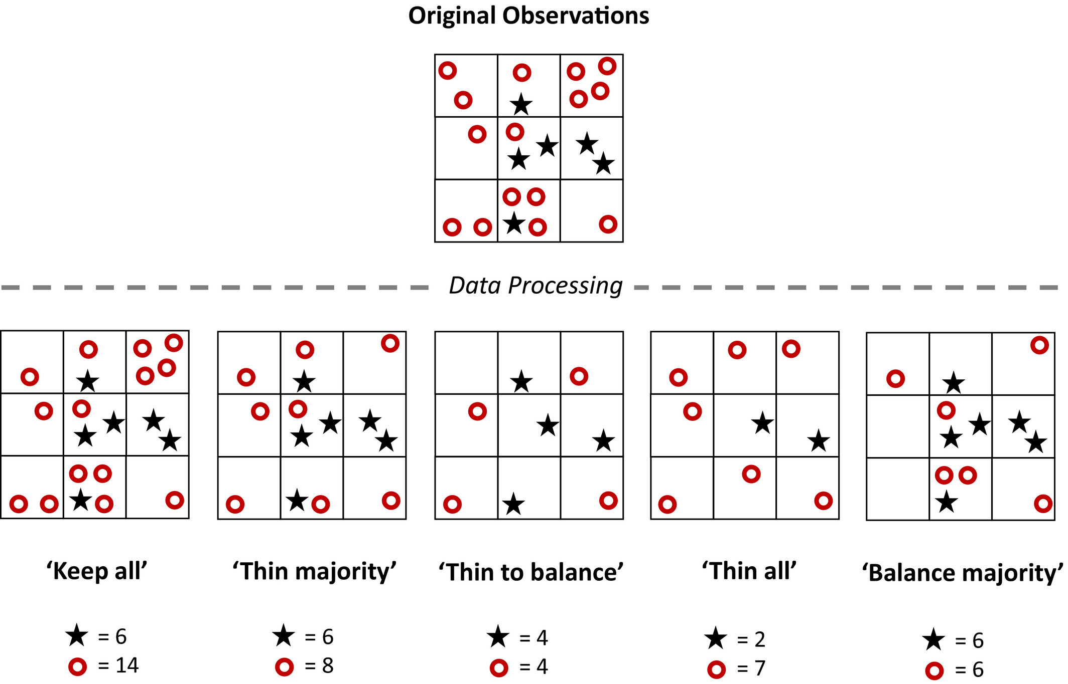
SPATIAL ANALYSIS
Spatial Thinning
Steen et al. 2019. https://doi.org/10.1111/2041-210X.13525

Slide 6
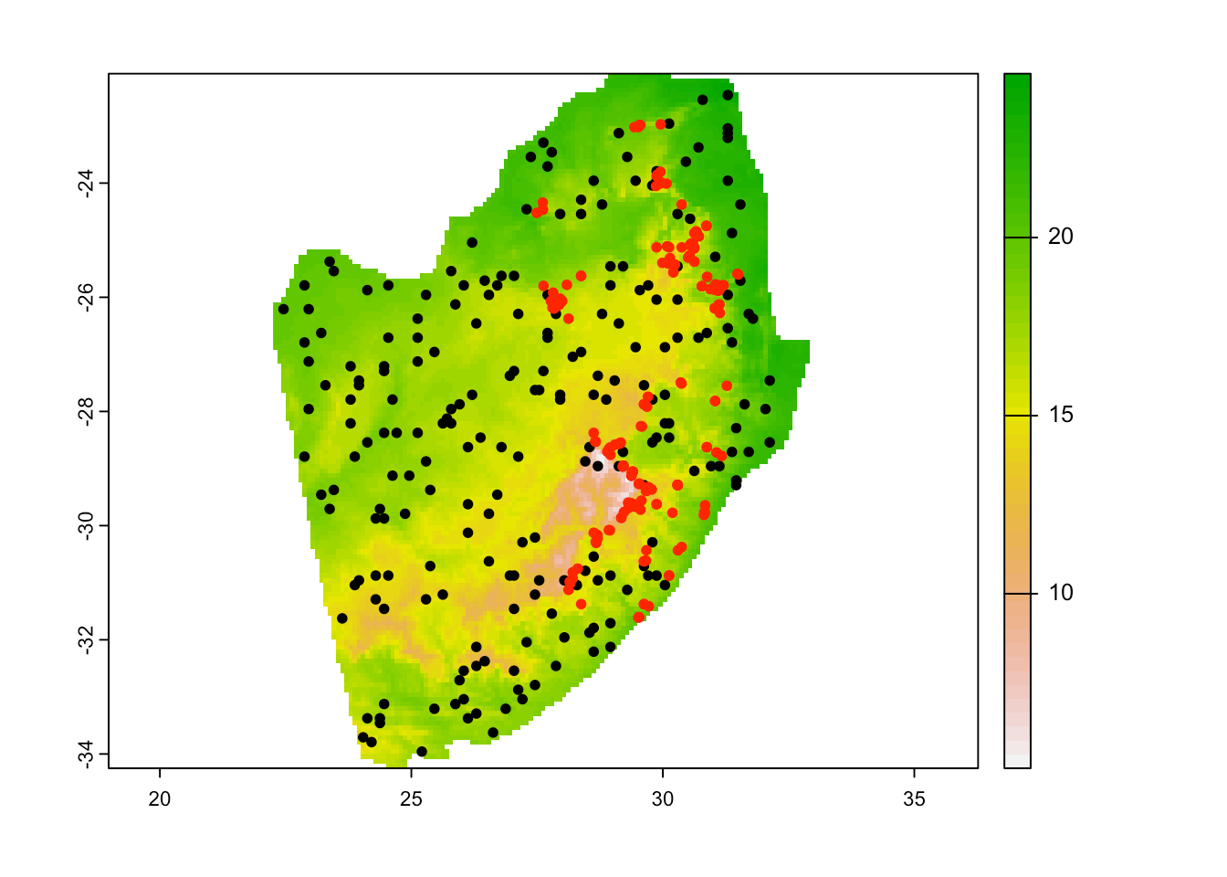
SPATIAL ANALYSIS
Locality Data
Presence points from GBIF
Absence points?
Best case scenario is to have known sites of absence
Alternatively we can create pseudo-absences or background points
Randomly generated
Generate based on geographic/environmental thresholds

Slide 7
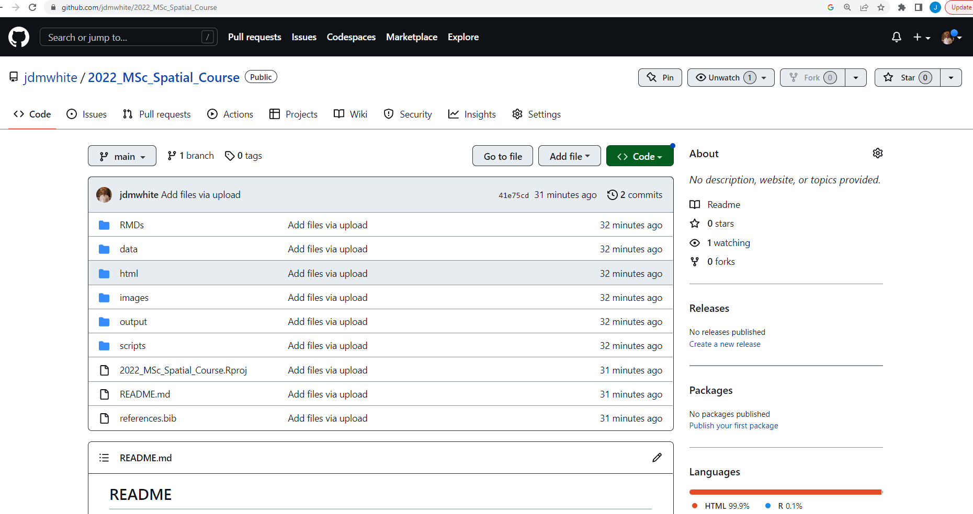
SPATIAL ANALYSIS
Download Material
github.com/jdmwhite/2022_MSc_Spatial_Course

